Slide 1
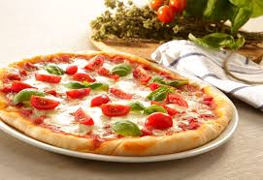
THE BATTLE OF NEIGHBORHOODS
A new Pizzeria in Basel

Slide 2
INTRODUCTION
As Italian abroad, a potential customer would like to open a traditional Italian pizzeria in Switzerland, more specifically in Basel. Some of the concern of the customers are:
How many restaurants are already in Basel
How many of them already offer ethical food
How many Pizzeria are there in Basel and surrounding
What is the best area where to open eventually
What could be the expected income of his Pizzeria

Slide 3
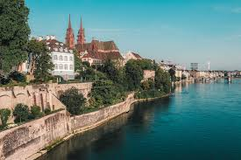
INTRODUCTION Few facts about Basel
Basel is a city in north-western Switzerland on the river Rhine. Basel is Switzerland's third-most-populous city (after Zürich and Geneva) with about 180,000 inhabitants.
Basel is a rich middle-sized city in north Switzerland
It is Multicultural
Provides a lot of business opportunities
Attracts thousand of visitors every year

Slide 4
PROJECT – HIGH LEVEL
The idea of the project is the creation of a model capable to predict the success of a new Restaurant in a city similar to Basel (midsize European city).
A high-level approach could be:
The customer decides what kind of restaurant wants to open and what is the target city
A website like Tripadvisor scrapped for the restaurant list in the selected city
Each restaurant is enriched with geographical data
The historical crime within a predetermined distance of all venues are obtained
A map is presented showing restaurant and crime statistics of the area
Areas are also evaluated in term of prestige and number of inhabitants
The main data science aspect of this project including:
Data Acquisition and Data Cleansing
Data Analysis

Slide 5
DATA
The principal source of data are the official statistics provided by Basel-Land website:
https://www.statistik.bs.ch/zahlen/tabellen/1-bevoelkerung/bestand-struktur.html
From this website will be possible to extract and scramble:
Name and area of the various districts
Population data (Local and immigrants)
Social Welfare quota & Net worth distribution

Slide 6
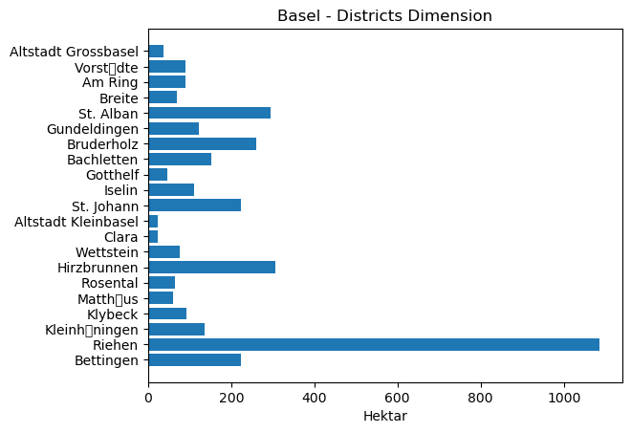
DATA VISUALIZATION
Name and area of the various districts

Slide 7
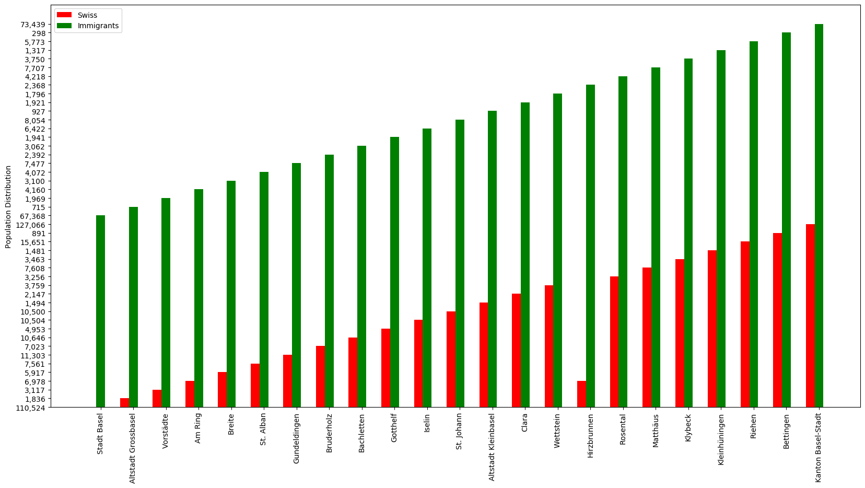
DATA VISUALIZATION
Population data (Local and immigrants)

Slide 8
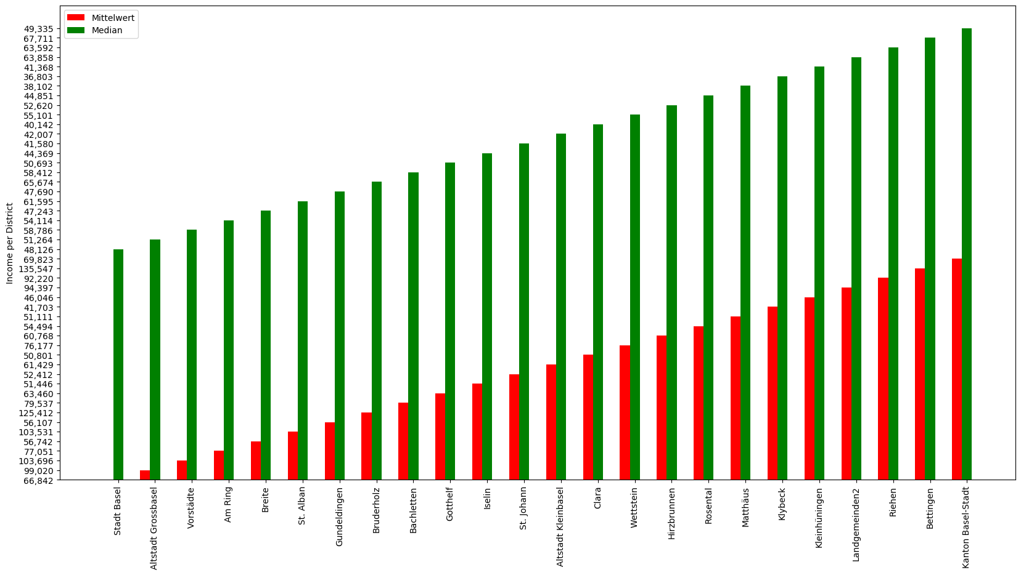
DATA VISUALIZATION
Social Welfare quota & Net worth distribution

Slide 9
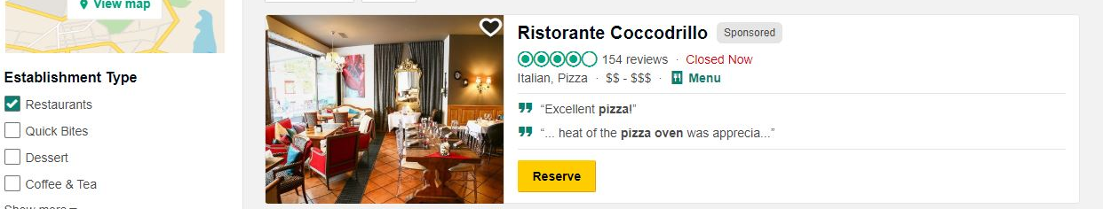
ANALYTIC APPROACH
Basel is a medium-small city with less than 200,000.00 citizens and 24 neighbourhoods.
The first step is to better understand the composition of Basel neighbourhoods, clustering the various quarters in an exploratory Data Analysis.
We will also scramble data from Tripadvisor, in order to understand actual Pizzerias distribution and average ranking and price evaluation.
https://www.tripadvisor.com/Restaurants-g188049-Basel.html

Slide 10
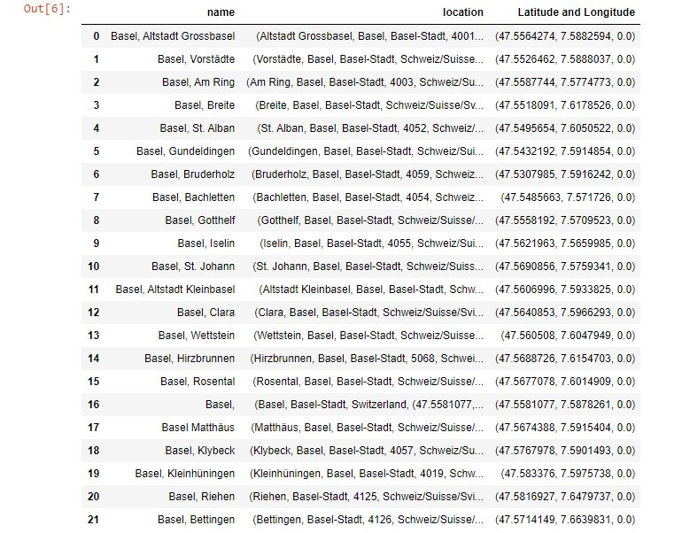
METHODOLOGY
The first step is to link neighbourhoods with their Latitude and Longitude. To do so we take advantage of geopy library: !pip install geopy.

Slide 11
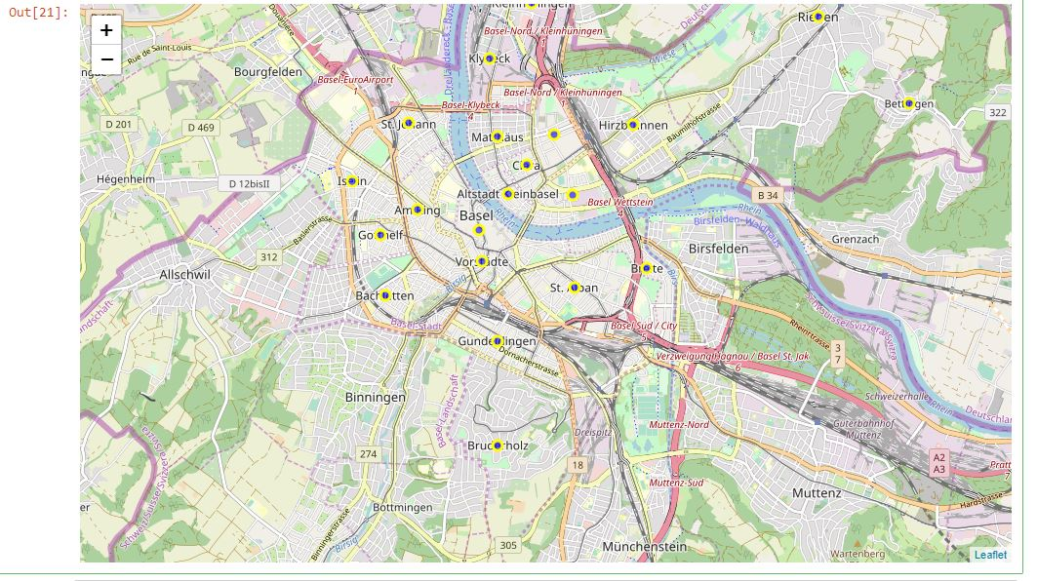
METHODOLOGY
Let now plot Basel city map, and as the second step let map the various neighbourhoods.
First of all, we need to identify Basel Latitude and Longitude:
Latitude: 47.55
Longitude: 7.6

Slide 12
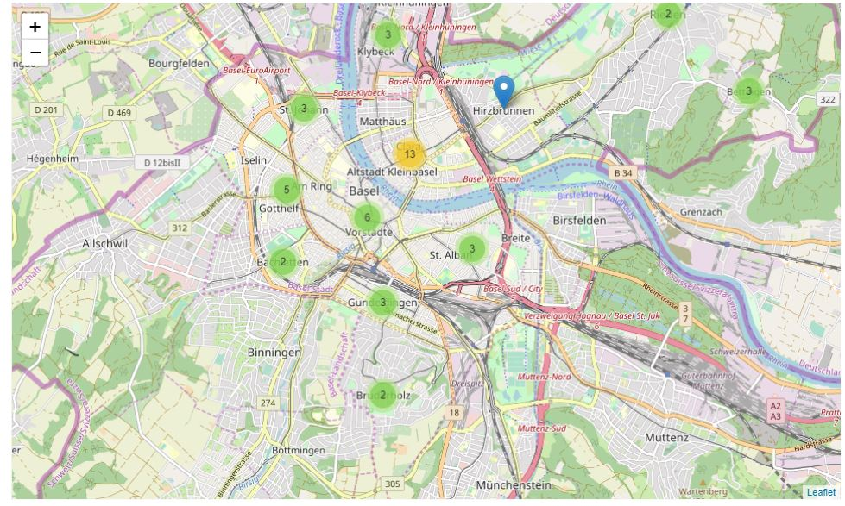
METHODOLOGY
We need now to figure out how is the actual Pizzeria market in Basel. In order to do so, we are going to scramble data from TRIPADVISOR
Data Scrambled are:
Restaurant Name
Price [0-5]
Evaluation[0-5]
Location
From the location, it is possible as well to extrapolate related latitude and longitude, clustering the restaurants altogether, according to the respective area.

Slide 13
METHODOLOGY
District | Average Price | Average Evaluation | Pizzerias in the District
Altstadt Grossbasel | 2.500000 | 3.500000 | 3
Altstadt Kleinbasel | 2.250000 | 4.250000 | 4
Am Ring | 2.500000 | 3.500000 | 2
Bachletten | 2.750000 | 4.000000 | 2
Bettingen | 2.000000 | 3.500000 | 3
Breite | 2.500000 | 3.500000 | 1
Bruderholz | 2.500000 | 3.750000 | 2
Clara | 2.500000 | 3.400000 | 5
Gotthelf | 2.500000 | 4.250000 | 2
Gundeldingen | 2.500000 | 3.333333 | 3
Hirzbrunnen | 2.500000 | 2.500000 | 1
Iselin | 1.000000 | 4.000000 | 1
Kleinhüningen | 3.000000 | 4.500000 | 1
Klybeck | 2.750000 | 3.750000 | 2
Matthäus | 2.500000 | 4.500000 | 1
Riehen | 1.750000 | 2.250000 | 2
Rosental | 2.500000 | 4.500000 | 1
St. Alban | 2.500000 | 3.000000 | 2
St. Johann | 1.833333 | 3.666667 | 3
Vorstädte | 2.666667 | 3.166667 | 3
Wettstein | 1.750000 | 3.500000 | 2
We need now to figure out how is the actual Pizzeria market in Basel. In order to do so, we are going to scramble data from TRIPADVISOR
Data Scrambled are:
Restaurant Name
Price [0-5]
Evaluation[0-5]
Location
From the location, it is possible as well to extrapolate related latitude and longitude, clustering the restaurants altogether, according to the respective area.

Slide 14
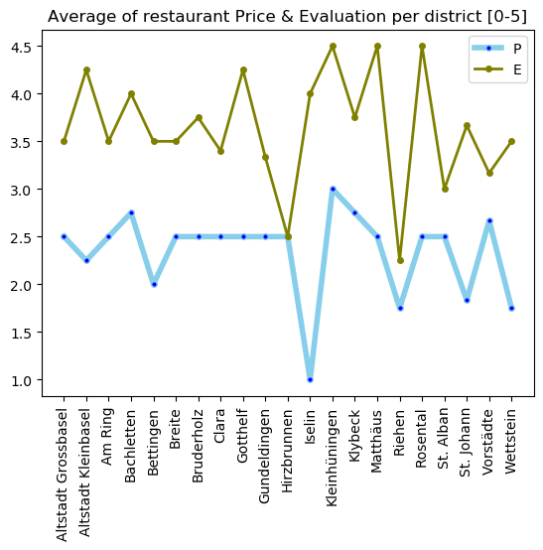
METHODOLOGY
We need now to figure out how is the actual Pizzeria market in Basel. In order to do so, we are going to scramble data from TRIPADVISOR
Data Scrambled are:
Restaurant Name
Price [0-5]
Evaluation[0-5]
Location
From the location, it is possible as well to extrapolate related latitude and longitude, clustering the restaurants altogether, according to the respective area.

Slide 15
METHODOLOGY It is now possible cluster all data in the same database
District | Restaurant Average Price | Restaurant Evaluation | Pizzeria number | Mittelwert | Median | Gini-Koeffizient4 | Mittelwert.1 | Median.1 | Summe | Schweizer | Ausländer | Total | Citizens/Pizzeria
Altstadt Grossbasel | 2.500000 | 3.500000 | 3 | 99020 | 51264 | 0.643 | 16990 | 6386 | 28475486 | 1836 | 715 | 2551 | 850.333333
Altstadt Kleinbasel | 2.250000 | 4.250000 | 4 | 61429 | 42007 | 0.533 | 9082 | 4495 | 14658590 | 1494 | 927 | 2421 | 605.250000
Am Ring | 2.500000 | 3.500000 | 2 | 77051 | 54114 | 0.518 | 11446 | 6497 | 70710469 | 6978 | 4160 | 11138 | 5569.000000
St. Johann | 1.833333 | 3.666667 | 3 | 52412 | 41580 | 0.486 | 6658 | 3560 | 72358543 | 10500 | 8054 | 18554 | 6184.666667
Vorstädte | 2.666667 | 3.166667 | 3 | 103696 | 58786 | 0.588 | 17096 | 7665 | 51698929 | 3117 | 1969 | 5086 | 1695.333333
Wettstein | 1.750000 | 3.500000 | 2 | 76177 | 55101 | 0.496 | 11237 | 6831 | 38442001 | 3759 | 1796 | 5555 | 2777.500000

Slide 16
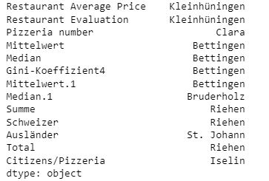
RESULTS
We can now use the below code in order to extrapolate the best District for each column:
test = Overall_Basel.set_index('District').select_dtypes('number')
test.head()
idx = test.idxmax()
idx

Slide 17
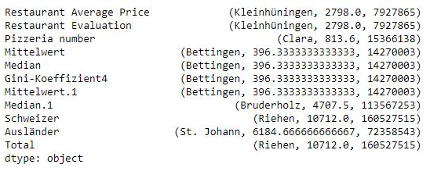
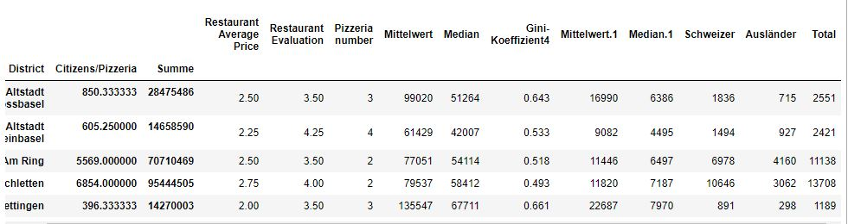
RESULTS
Anyway, it seems that there is more than one main parameter that should trigger our decision. For this reason, we adapt the code in order to consider more than one parameter.

Slide 18
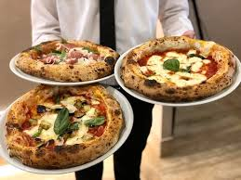
DISCUSSION
The data clearly show that there is still room for a new Pizzeria in Basel. From the data we can state the following:
The 47 Pizzerias currently in Basel are considered expansive but with average quality.
Basel is a rich city, where each citizen has an overall average income of 53.000,00 CHF
There are 5 quarters were it seems to e profitable open a new Pizzeria:
Bettingen
Bruderholz
Clara
Riehen
St. Johann
Among all of them, the one with the best combination of population, average income, other potential competitors in the area is Bettingen.

Slide 19
CONCLUSION
As a matter of fact, this analysis has been performed with limited data and with a very tight timeline. Anyway with the data available and with the analysis performed it was possible to:
Analyse Basel Neighbourhoods main characteristics
Analyse current Pizzerias location, prices, and ranking
Propose the best locations where to open a new pizzeria, according to the data available.
THANK YOU

